Slide 1
Crime Pattern Analysis and Prediction using Machine Learning
Team Guide : Pradeep Nazareth
Team Head : Lathesh Kumar S R (4AL23AI400)
Team Members :Sanket Patil (4AL22AI043)
Shivamani M Nayak (4AL22AI051)
Tejashwini SM (4AL22AI060)

Slide 2
Introduction
Crime detection, analysis, and prediction are key for modern law enforcement.
Rising urbanization and population growth increase crime rates.
Machine learning and geospatial analysis help find hidden crime patterns.
Predictive models identify hotspots and improve resource allocation.
Combining data from social, economic, and other sources boosts accuracy.
The goal is to enable proactive strategies and build safer communities.

Slide 3
Research gap
Prior research lacked systematic analysis of large-scale data especially countries like US and India.
Earlier works ignored environmental or social contexts.
Few studies tested simple interpretable models like KNN in crime analysis
Lack of hybrid comparative analysis in crime prediction.
Government open data sources underutilized in crime analytics.

Slide 4
PROBLEM STATEMENT
Crime prediction models lack real-time accuracy due to inconsistent data.
Processing large, unstructured crime data is challenging.
Geo-spatial techniques are underutilized in crime mapping.
Privacy concerns and algorithmic bias exist in crime prediction models.
Law enforcement faces difficulty in implementing AI-driven crime analysis.

Slide 5
OBJECTIVES
Analyze crime patterns using historical and real-time data.
Utilize machine learning for crime classification and prediction.
Implement geo-spatial mapping to identify crime hotspots.
Address privacy concerns while ensuring data security.

Slide 6
METHODOLOGY
Data Collection & Preprocessing: Used Kaggle’s US based crime data, cleaned data, handled missing values, normalized features.
Feature Engineering: Selected key features (time, day, location), created new indicators like crime frequency and high-risk zones, and applied K-Means clustering.
Model Implementation: Built and tested four ML models – Random Forest, Xgboost and Decision Tree,K-Nearest Neighbors – for crime prediction and hotspot detection.
Training & Validation: Split data (70% training, 30% testing), performed 5-fold cross-validation.
Performance Evaluation: Measured accuracy, precision, recall, and F1-score, and visualized results with confusion matrices and hotspot maps, identifying Random Forest as the best model.

Slide 7
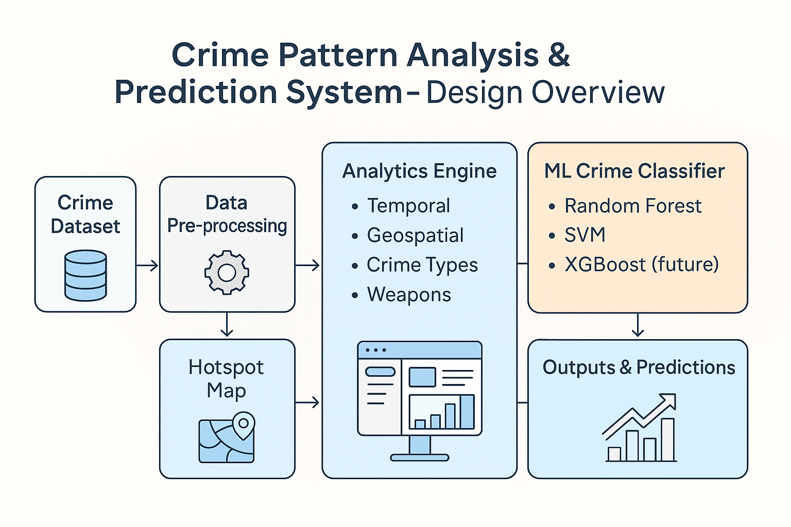
Design

Slide 8
Data sets
Government & Open Data Portals
Kaggle – Crime Datasets:- https://www.kaggle.com/datasets?search=crime
data.gov (USA):- https://catalog.data.gov/dataset?tags=crime
FBI Crime Data Explorer:- https://cde.ucr.cjis.gov/LATEST/webapp/#/pages/home
City of Chicago Data Portal:- https://data.cityofchicago.org/Public-Safety/Crimes-2001-to-Present/ijzp-q8t2
NYC Open Data – NYPD Complaint Data :- https://data.cityofnewyork.us/Public-Safety/NYPD-Complaint-Data-Historic/qgea-i56i
International Crime Data
UK Police Data :- https://data.police.uk/
UNODC (United Nations Office on Drugs and Crime) :- https://dataunodc.un.org
Eurostat Crime Data - https://ec.europa.eu/eurostat/web/crime/

Slide 9
Machine Learning MODELS
Algorithms used
Random Forest classifier- High-accuracy, robust crime prediction.
Xgboost - Heighly optimized gradient boosting algorithm
Decision Tree - Clear, interpretable prediction rules.
K-Nearest Neighbors - Pattern matching by comparing similar past crimes.

Slide 10
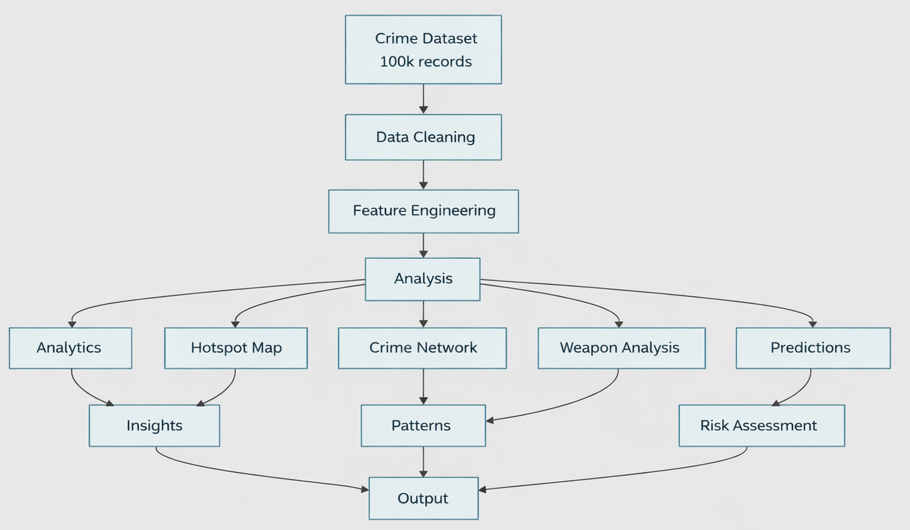
Flow Chart

Slide 11
Conclusion
Uses machine learning and data mining for crime pattern detection.
Applies K-means, Random Forest, and regression for analysis.
Analyzes spatial, temporal, and behavioral crime data.
Expert feedback improves model accuracy and insights.
Helps police predict hotspots and prevent crimes.

Slide 12
THANK YOU

Slide 13
Research paper Publication
Accepted for ISCCSC -2025
“Crime Pattern Analysis and Prediction using Machine Learning”

Slide 14
Survey papers
40 Survey paper by the all the team members
https://drive.google.com/drive/folders/18d00GwXuNXqRFZH--YB5NlXmPoPds1ok?usp=sharing

